Slide 1
PROBLEM STATEMENT & UNDERSTANDING
HOUSING-PRICE-PREDICTION DATASET
Houses are one of the necessary need of each and every person around the globe and therefore housing and real estate market is one of the markets which is one of the major contributors in the world’s economy
Data science comes as a very important tool to solve problems in the domain to help the companies increase their profits
Which company working on house related project then Data scientist give decision to those companies that you should pay more attention to some house related important factors while working on housing-project because the customer looks more at those factors before taking the house , If your House-project meets those factors then it more likely that the customer will take it
We have a Housing-price-prediction dataset, this dataset contain input-data & Target(SalePrice)
• Which variables are important to predict the SalePrice , we focus at this thing

Slide 2
EDA Steps and visualizations
* IMPORT NECESSARY LIBRARY PANADAS, NUMPY, MATPLOTLIB, SEABORN, SCIPY, SKLEARN, XGBOOST
.First load the dataset on jupyter notebook and print it then check the shape of the dataset
. I started looking at randomly some rows and columns of dataset and tried to understand
. While checking the null elements of the dataset , then found some Variables which whole elements are Null so we dropped these Variables
.we started to impute those Variables in which minimum null value by using groupby with mean, mode pandas method
. I visualize the data using Matplotlib & seaborn
. Four types of plotting were used on the columns of this Dataset such as Countplot, Barplot, Lineplot & Scatterplot
scatterplot using on continuous attributes & countplot use only on categorical attributes & in barplot use on categorical, continuous Attributes
.Plotting correlation plot of this dataset through heatmap from using seaborn library. In this correlation plot , I see how each Attributes is related to each other and to the target-Attribute and from, this correlation plot we get a lot information about the dataset like how positive or negative each column is correlated with each other
. Correlation plot show some Variables that more positive correlated with Target & some Variables are highly positive correlated with each other
. Plotting Pairplot by using Seaborn after correlation plot then we see that it is given same information what we get from correlation plot only difference was Visualization

Slide 3
.After plotting Correlation plot & Pairplot , we get most of the information about all the Attributes of the dataset
= Now I used scatterplot, Barplot & Lineplot to understand the all Attributes of dataset in a better way and finally after plotting I got information about all the Attributes of the Dataset which Attributes are more important to predict the Target-attribute and which are not
It also came to know that which Attributes are useless in dataset for predicting Target
--we did a lot of EDA/Data-Preprocessing work on this Housing-Price-Prediction Dataset
.These all are most important important Variables for predicting the Target
(lotArea, OverallQual, OverallCond,YearBuilt, RoofStyle,Exterior1st, ExterQual, BsmtQual,BsmtCond,BsmtFinType1
,BsmtFinType2, HeatingQC, GrLivArea, FullBath,KitchenQual, GarageArea, GarageCars, GarageFinish,GarageQual,
OpenPorchSF, Neighborhood,..)
. In this dataset a few more than 30 percent of columns are more positive correlated to SalePrice
and above 80% information given by these columns to predict the Target

Slide 4
Steps and assumptions used to complete the project
1. Load the Dataset , check the shape and check Null value
2. Impute the null value of some Variables & removed some variables which doesn't able to imputable
3. Describe the Dataset using describe function of pandas then we saw that some Continuous Variables very huge differences in their elements distribution , almost 85 percent elements are similar and another elements are
10 times greater than 85 percent parts of their
4. we used value_counts() function to check categorical value , after using value_counts we saw that more 98 percent elements are same of size Variables so such type of variables doesn't give any information to predict the target so we dropped it
5. Now we starting countplot, Lineplot, Barplot, Scatterplot after using these all plotting method we use heatmap to plot
Dataset-Correlation
6. after done data-cleaning part & all Visualization part we considered over all plots then we found that all information of Dataset and which Variables are important and which are not , along with we also get information of Outliers , skewness & Multicollinearity of the Dataset Variables
7. apply Label-Encoding on Ordinal type categorical Variables & Onehot encoding on Nominal type Variables But I apply Label-encoding on Nominal type Variables then there was no difference in accuracy
8. checking skewness on continuous Variables & remove skewness of skewed Variables
9. using Boxpot & Zscore to check Outliers then most of continuous Variables have outliers , we using Zscore to solve it
10. Checking Multicollinearity with VIF method to remove multicorrelated input-Variables
11. divide the Dataset into two parts Input-data & Target
12. Scaling the Input-Data with StandardScaler
13. I have done all the process of Data-Preprocessing which can be done on this dataset, now the data is completely clean to Train the model
# Finally after Data-Preprocessing , 60 Attributes were left on which the model was to be fitted,
# After this , PCA was used on the scaled data, then 55 PCA_componenets covered the 90 percent of variance of data
# But we don't use PCA

Slide 5
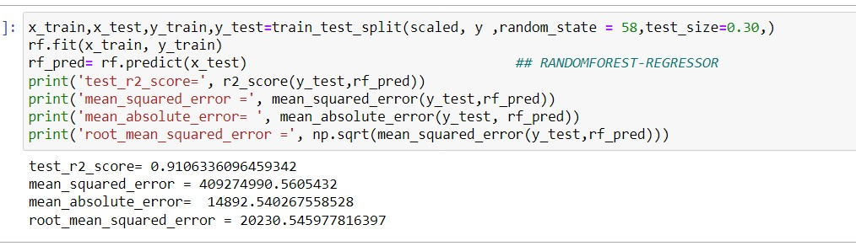
Finalized model
1. First we do Train_test_split on input-data & target-attribute then data split into train & test data , fit the model on train data then test the model accuracy on test data
2. I used LogisticRegression, RandomForest-Regression, AdaBoost-Regressor & XGBRegressor to fit the models and after train the models checking r2_score then the highest r2_score = 90 percent obtained from RandomForest-Regressor & XGB-Regressor . In machine learning in the REGRESSION-problem, the RandomForest r2_score on test data is
more compare than another algorithms
3. Applying cross_validation with Kfold on all four model then we get maximum cross_validation_score from RandomForest-Regressor = 89 percent

Slide 6
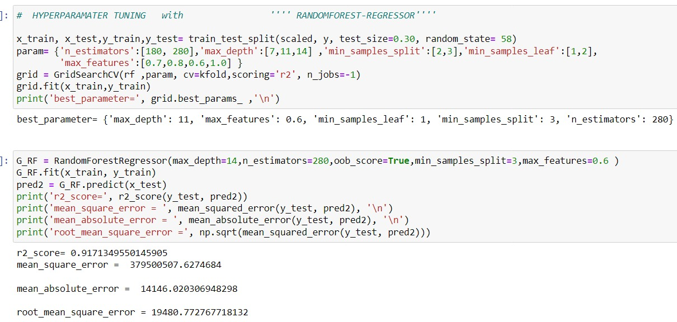
4.we done Hyperparameter tunning over RandomForest_Model because 'r2_score' of RandomForest was highest compare to all model & 'root_mean_squared_error' was less compare to another model
. we get highest Cross_validation_score from RandomForest_Model
HyperTunned_Model r2_score = 91%

Slide 7
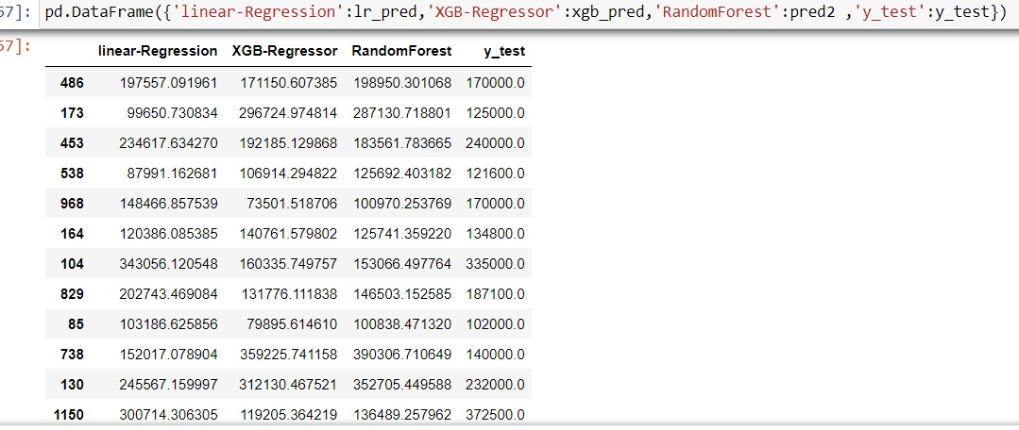
. we make HyperParameter tunning on Randomforest-Model and last predict the test data with this Model

Slide 8
conclusion
--we did a lot of EDA/Data-Preproessing work on this Housing-Price-Prediction Dataset
.Then we know, These all are most important important Variables for predicting the Target , such as
( lotArea,OverallQual,OverallCond,YearBuilt,RoofStyle,Exterior1st,ExterQual,BsmtQual,BsmtCond,BsmtFinType1,
BsmtFinType2,HeatingQC,GrLivArea,FullBath,KitchenQual,GarageArea,GarageCars,GarageFinish,GarageQual,
OpenPorchSF,Neighborhood,..)
. After that build model on those important input-columns
.when more and more columns of Input-Data are positive correlated with Target('SalePrice' of housing-dataset)
in REGRESSION Problem then it is easier for Machine-Learing model to predict Target it means Continuous value
.If none of the columns of the input-data that positive correlated with target or very less in the REGRESSION PROBLEM,
then there would be more difference between the predicted value & original value
.example = we do analysis the Flight-fare-price dataset and very few columns of this dataset was more positive correlated
with target, when we build a model using with RandomForest-Regressor then r2_score on test-data was 90 percent
but I had a seperate preprocessed test data and we make model to predict on this test-data then it came quite
different from the original value because input data very less correlated or no relation with target
… We want to make a best ML model but best ML model is nothing without best / accurate Data

